Slide 1
Data Analysis using R
By
Dr.Parkavi.A
Unit 2
Lec 1

Slide 2
Data Visualization in R
graphs, charts, maps
decisions

Slide 3
Airquality data set
Ozone | Solar R. | Wind | Temp | Month | Day
41 | 190 | 7.4 | 67 | 5 | 1
36 | 118 | 8.0 | 72 | 5 | 2
12 | 149 | 12.6 | 74 | 5 | 3
18 | 313 | 11.5 | 62 | 5 | 4
NA | NA | 14.3 | 56 | 5 | 5
28 | NA | 14.9 | 66 | 5 | 6

Slide 4
Types of Data Visualizations

Slide 5
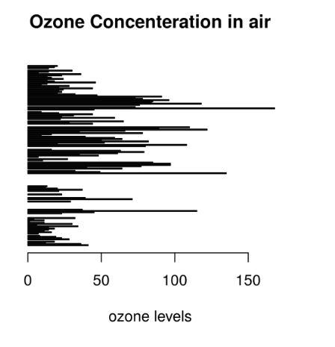
Bar Plot
horizontal and vertical
To perform a comparative study between the various data categories in the data set.
To analyze the change of a variable over time in months or years.
# Horizontal Bar Plot for
# Ozone concentration in air
barplot(airquality$Ozone,
main = 'Ozone Concenteration in air',
xlab = 'ozone levels', horiz = TRUE)

Slide 6
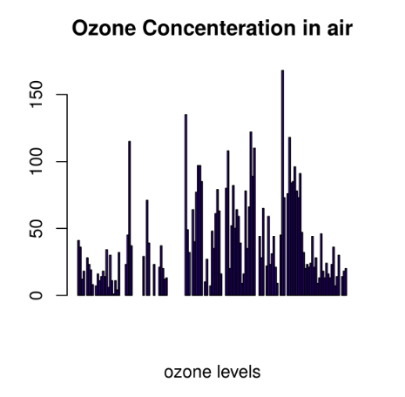
Eg
# Vertical Bar Plot for
# Ozone concentration in air
barplot(airquality$Ozone, main = 'Ozone Concenteration in air', xlab = 'ozone levels', col ='blue', horiz = FALSE)

Slide 7
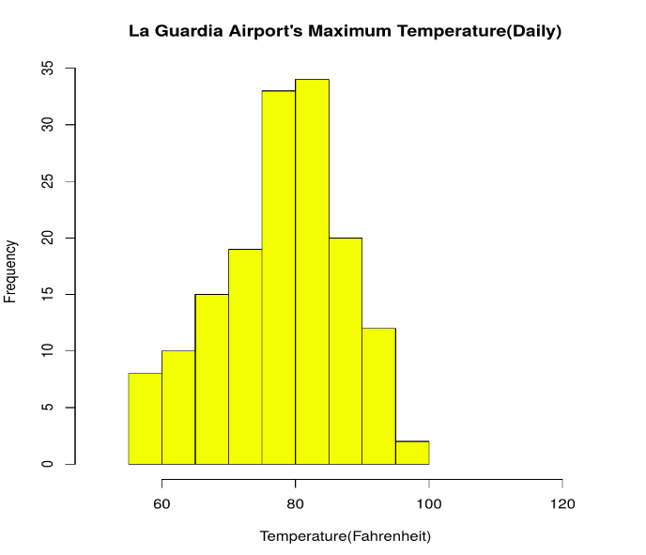
Histogram
like a bar chart as it uses bars of varying height to represent data distribution.
values are grouped into consecutive intervals called bins
To verify an equal and symmetric distribution of the data.
To identify deviations from expected values.
# Histogram for Maximum Daily Temperature
data(airquality)
hist(airquality$Temp, main ="La Guardia Airport's\
Maximum Temperature(Daily)",
xlab ="Temperature(Fahrenheit)",
xlim = c(50, 125), col ="yellow",
freq = TRUE)

Slide 8
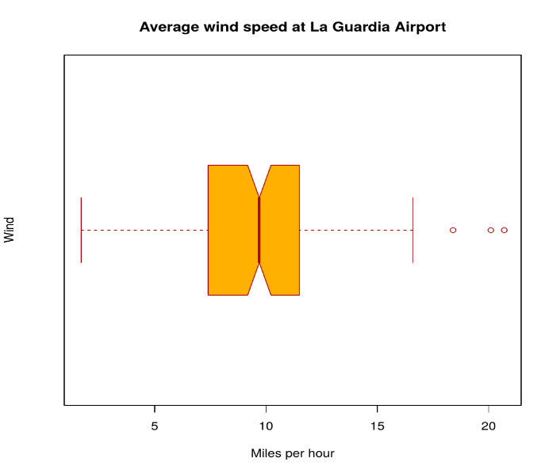
Box Plot
data is presented graphically using a boxplot
minimum and maximum data point, the median value, first and third quartile, and interquartile range.
# Box plot for average wind speed
data(airquality)
boxplot(airquality$Wind, main = "Average wind speed\
at La Guardia Airport",
xlab = "Miles per hour", ylab = "Wind",
col = "orange", border = "brown",
horizontal = TRUE, notch = TRUE)

Slide 9
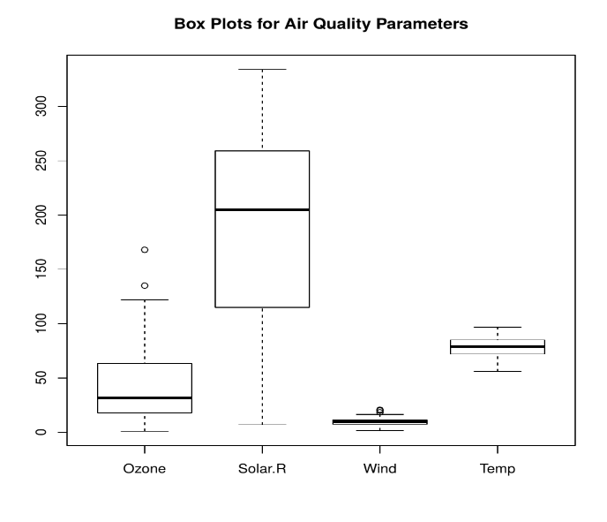
eg
To give a comprehensive statistical description of the data through a visual cue.
To identify the outlier points that do not lie in the inter-quartile range of data.
# Multiple Box plots, each representing
# an Air Quality Parameter
boxplot(airquality[, 0:4],
main ='Box Plots for Air Quality Parameters')

Slide 10
Boxplots
used to display information in the form of distribution by drawing boxplots
This distribution of data is based on five sets (minimum, first quartile, median, third quartile, and maximum).
x: This parameter sets as a vector or a formula.
data: This parameter sets the data frame.
notch: This parameter is the label for horizontal axis.
varwidth: This parameter is a logical value. Set as true to draw width of the box proportionate to the sample size.
main: This parameter is the title of the chart.
names: This parameter are the group labels that will be showed under each boxplot.

Slide 11
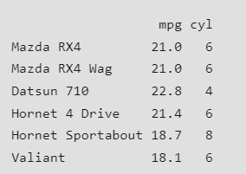
eg
input <- mtcars[, c('mpg', 'cyl')]
print(head(input))

Slide 12
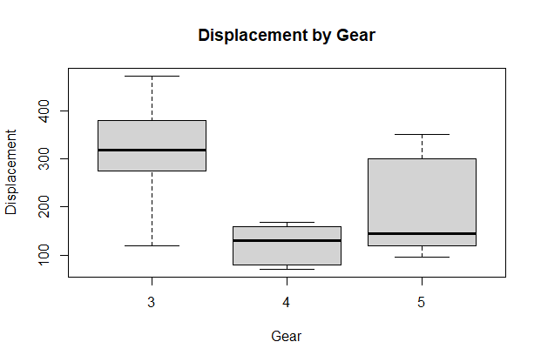
eg
# Load the dataset
data(mtcars)
# Create the box plot
boxplot(disp ~ gear, data = mtcars,
main = "Displacement by Gear",
xlab = "Gear",
ylab = "Displacement")

Slide 13
Boxplot using notch
Find out how the medians of different data groups match with each other.

Slide 14
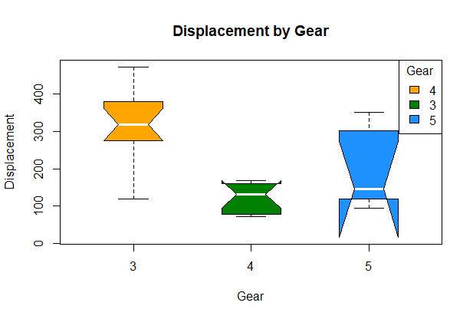
eg
# Load the dataset
data(mtcars)
# Set up plot colors
my_colors <- c("#FFA500", "#008000", "#1E90FF", "#FF1493")
# Create the box plot with customized aesthetics
boxplot(disp ~ gear, data = mtcars,
main = "Displacement by Gear", xlab = "Gear", ylab = "Displacement",
col = my_colors, border = "black", notch = TRUE, notchwidth = 0.5,
medcol = "white", whiskcol = "black", boxwex = 0.5, outpch = 19,
outcol = "black")
# Add a legend
legend("topright", legend = unique(mtcars$gear),
fill = my_colors, border = "black", title = "Gear")

Slide 15
Contd..
col: Uses a vector of colours (my_colors) to change the fill colour of the boxes. borders: Sets the box borders’ colour to black. notch: To illustrate confidence intervals, a notch is added to the boxes. notchwidth: Manages the notches’ width. medcol: Makes the median line’s colour white. whiskcol: Sets the whiskers’ colour to black with the whiskcol command. boxwex: Modifies the boxes’ width. outpch: Sets the outliers’ shapes to solid circles. outcol: Changes the outliers’ colour to black.

Slide 16
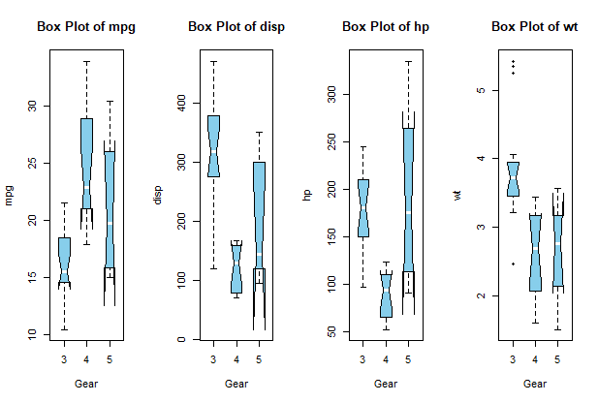
Multiple Boxplot
# Load the dataset
data(mtcars)
# Define the variables for the box plots
variables <- c("mpg", "disp", "hp", "wt")
# Set up the plotting layout
par(mfrow = c(1, length(variables)))
# Create the box plots
for (var in variables) {
boxplot(get(var) ~ gear, data = mtcars,main = paste("Box Plot of", var),xlab = "Gear",ylab = var, col = "skyblue",
border = "black", notch = TRUE, notchwidth = 0.5,medcol = "white",
whiskcol = "black",boxwex = 0.5, outpch = 19, outcol = "black")
}
# Reset the plotting layout
par(mfrow = c(1, 1))

Slide 17
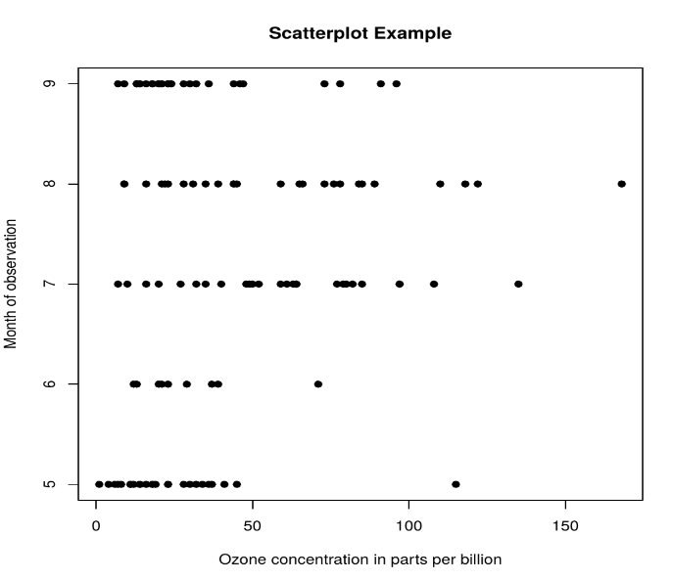
Scatter Plot
# Scatter plot for Ozone Concentration per month
data(airquality)
plot(airquality$Ozone, airquality$Month,
main ="Scatterplot Example",
xlab ="Ozone Concentration in parts per billion",
ylab =" Month of observation ", pch = 19)

Slide 18
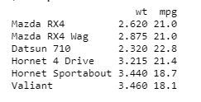
Creating a Scatterplot Graph
We are using the required parameters to plot the graph.
In this ‘xlab’ describes the X-axis and ‘ylab’ describes the Y-axis.
input <- mtcars[, c('wt', 'mpg')]
print(head(input))

Slide 19
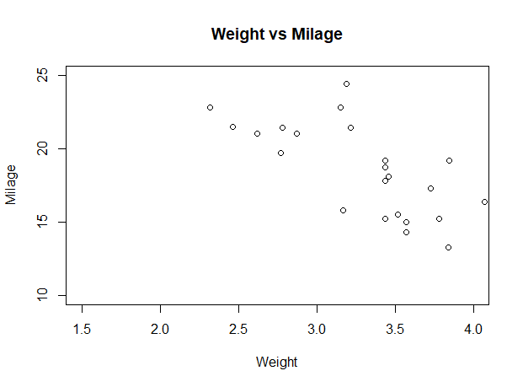
eg
# Get the input values.
input <- mtcars[, c('wt', 'mpg')]
# Plot the chart for cars with
# weight between 1.5 to 4 and
# mileage between 10 and 25.
plot(x = input$wt, y = input$mpg,
xlab = "Weight",
ylab = "Milage",
xlim = c(1.5, 4),
ylim = c(10, 25),
main = "Weight vs Milage"
)

Slide 20
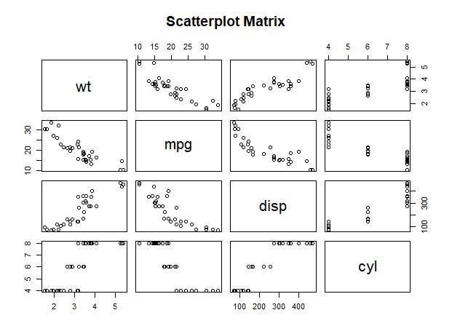
Scatterplot Matrices
# Plot the matrices between
# 4 variables giving 12 plots.
# One variable with 3 others
# and total 4 variables.
pairs(~wt + mpg + disp + cyl, data = mtcars,
main = "Scatterplot Matrix")

Slide 21
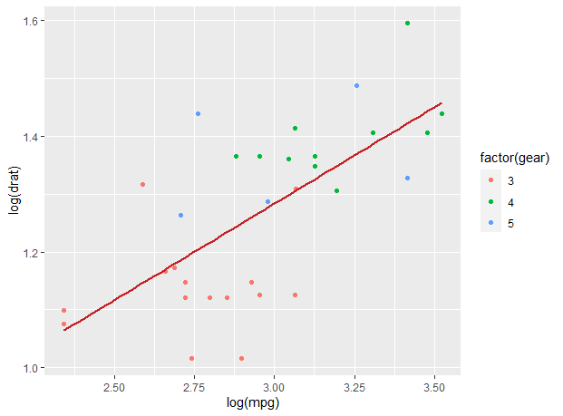
Scatterplot with fitted values
# Loading ggplot2 package
library(ggplot2)
# Creating scatterplot with fitted values.
# An additional function stst_smooth
# is used for linear regression.
ggplot(mtcars, aes(x = log(mpg), y = log(drat))) +
geom_point(aes(color = factor(gear))) +
stat_smooth(method = "lm",
col = "#C42126", se = FALSE, size = 1
)

Slide 22
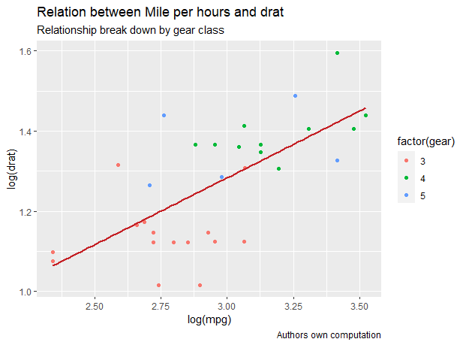
Adding title with dynamic name
# Loading ggplot2 package
library(ggplot2)
# Creating scatterplot with fitted values.
# An additional function stst_smooth
# is used for linear regression.
new_graph<-ggplot(mtcars, aes(x = log(mpg),y = log(drat))) +geom_point(aes(color = factor(gear))) + stat_smooth(method = "lm",col = "#C42126",se = FALSE, size = 1)
# in above example lm is used for linear regression
# and se stands for standard error.
# Adding title with dynamic name
new_graph + labs(title = "Relation between Mile per hours and drat",
subtitle = "Relationship break down by gear class",
caption = "Authors own computation"
)

Slide 23
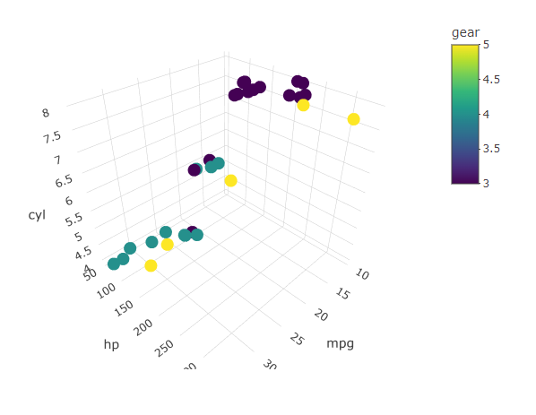
3D Scatterplots
# 3D Scatterplot
library(plotly)
attach(mtcars)
plot_ly(data=mtcars,x=~mpg,y=~hp,z=~cyl,color=~gear)

Slide 24
Contd..
To show whether an association exists between bivariate data.
To measure the strength and direction of such a relationship.

Slide 25
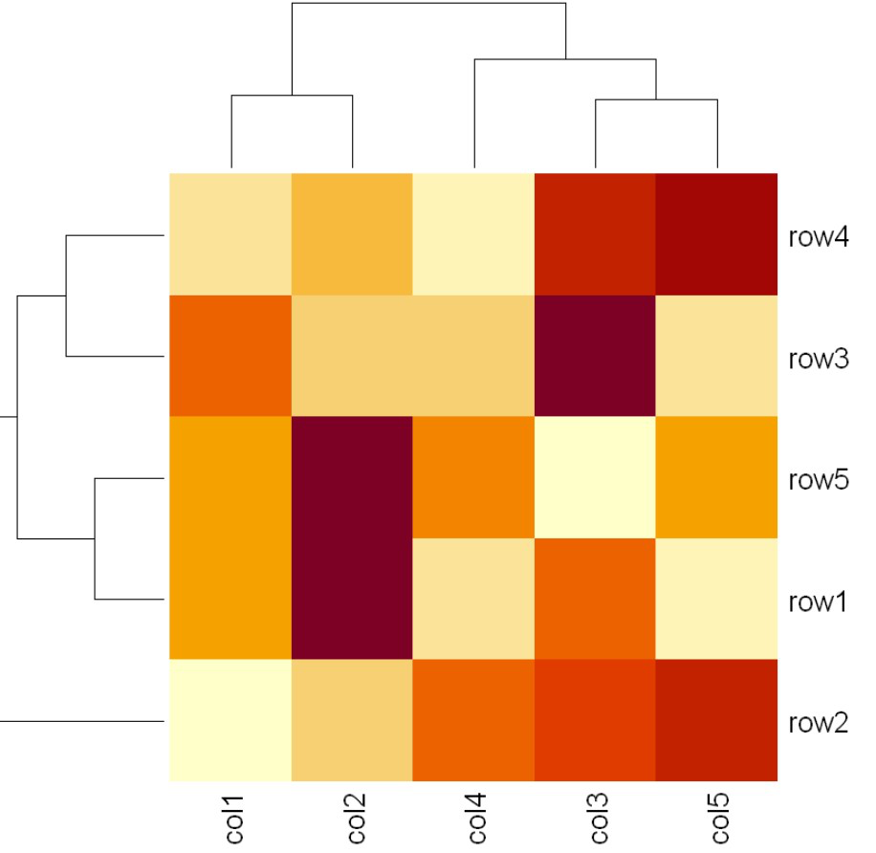
Heat Map
graphical representation of data using colors to visualize the value of the matrix.
# Set seed for reproducibility
# set.seed(110)
# Create example data
data <- matrix(rnorm(50, 0, 5), nrow = 5, ncol = 5)
# Column names
colnames(data) <- paste0("col", 1:5)
rownames(data) <- paste0("row", 1:5)
# Draw a heatmap
heatmap(data)

Slide 26
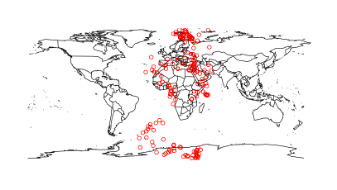
Map visualization in R
install.packages("maps")
# Read dataset and convert it into
# Dataframe
data <- read.csv("worldcities.csv")
df <- data.frame(data)
# Load the required libraries
library(maps)
map(database = "world")
# marking points on map
points(x = df$lat[1:500], y = df$lng[1:500], col = "Red")

Slide 27
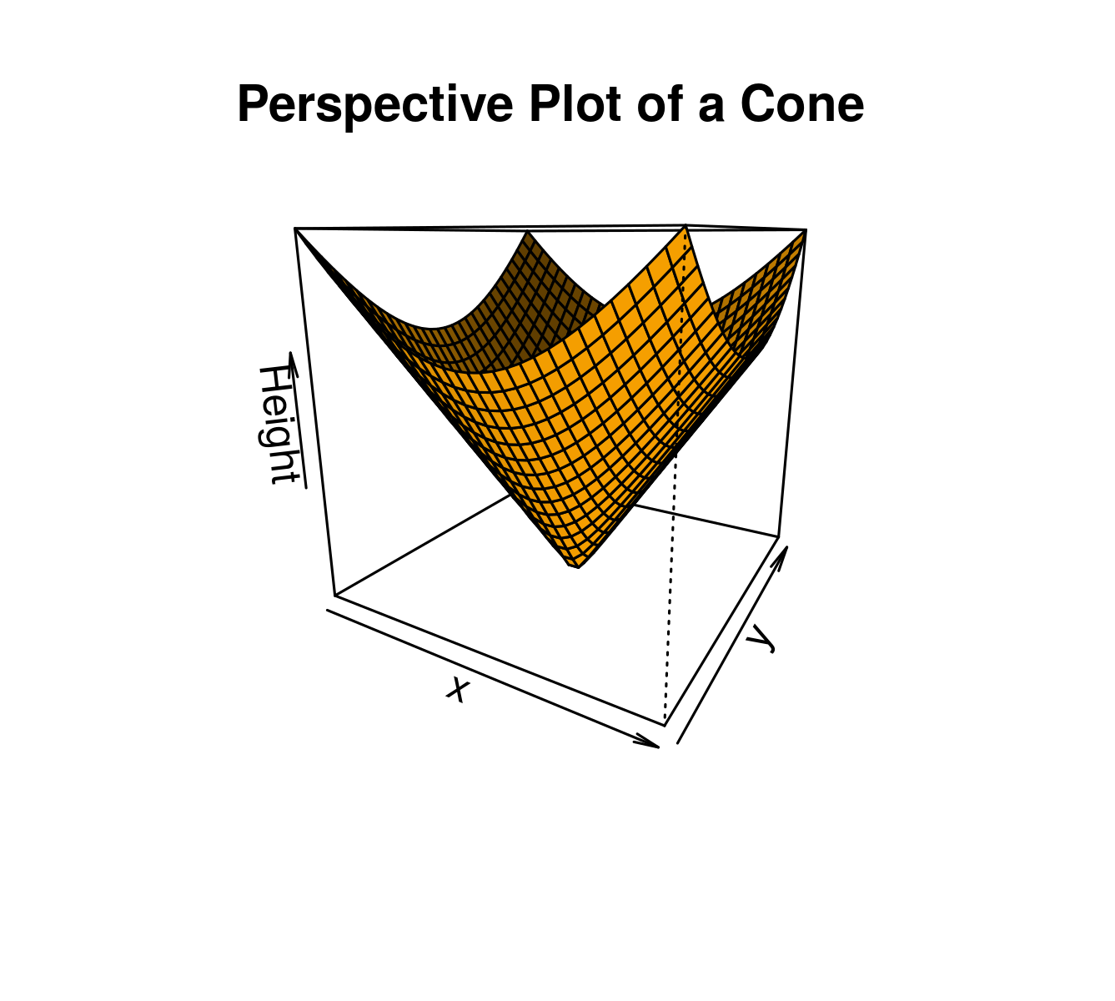
3D Graphs in R
preps() function
create 3D surfaces
# Adding Titles and Labeling Axes to Plot
cone <- function(x, y){
sqrt(x ^ 2 + y ^ 2)
}
# prepare variables.
x <- y <- seq(-1, 1, length = 30)
z <- outer(x, y, cone)
# plot the 3D surface
# Adding Titles and Labeling Axes to Plot
persp(x, y, z,
main="Perspective Plot of a Cone",
zlab = "Height",
theta = 30, phi = 15,
col = "orange", shade = 0.4)

